Slide 1
TRAVEL KING
Group Members:
Khai Phan, Adrian Recchi, Luqman Dewji, Zain Ali

Slide 2
Business Process Model
Search Price Deals
Changes in Reservation
Customer Support System
Popular Vacation Package
Price check (Mix&Match) for Hotels and Rental Cars
Membership System
Recommendation for Flight/Hotel/Rental Cars/Package

Slide 3
Stakeholder Analysis Matrix
Stakeholder | Role | Power | Interest
Customer | User | High | Low
Investors | Decision Maker | High | Medium
Company President | Decision Maker | High | High
Marketing Manager | Decision Maker | Medium | High
Marketing Employee | Developer | Low | Medium
Travel Advisor Manager | Decision Maker | Medium | High
Travel Advisor Employee | Developer | Low | Medium

Slide 4
Stakeholder Analysis Matrix
Stakeholder | Role | Power | Interest
Customer Service Manager | Decision Maker | Medium | High
Customer Service Employee | Developer | Low | Low
Accounts Receivable Manager | Decision Maker | Medium | High
Accounts Receivable Employee | Developer | Low | Low
Programmer | Developer | Low | High
System Analyst | Legislator | Medium | High

Slide 5
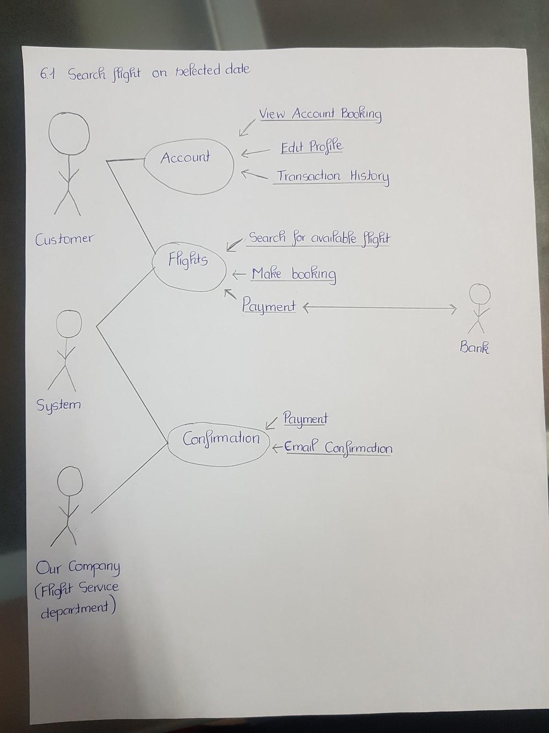
Flight Booking

Slide 6
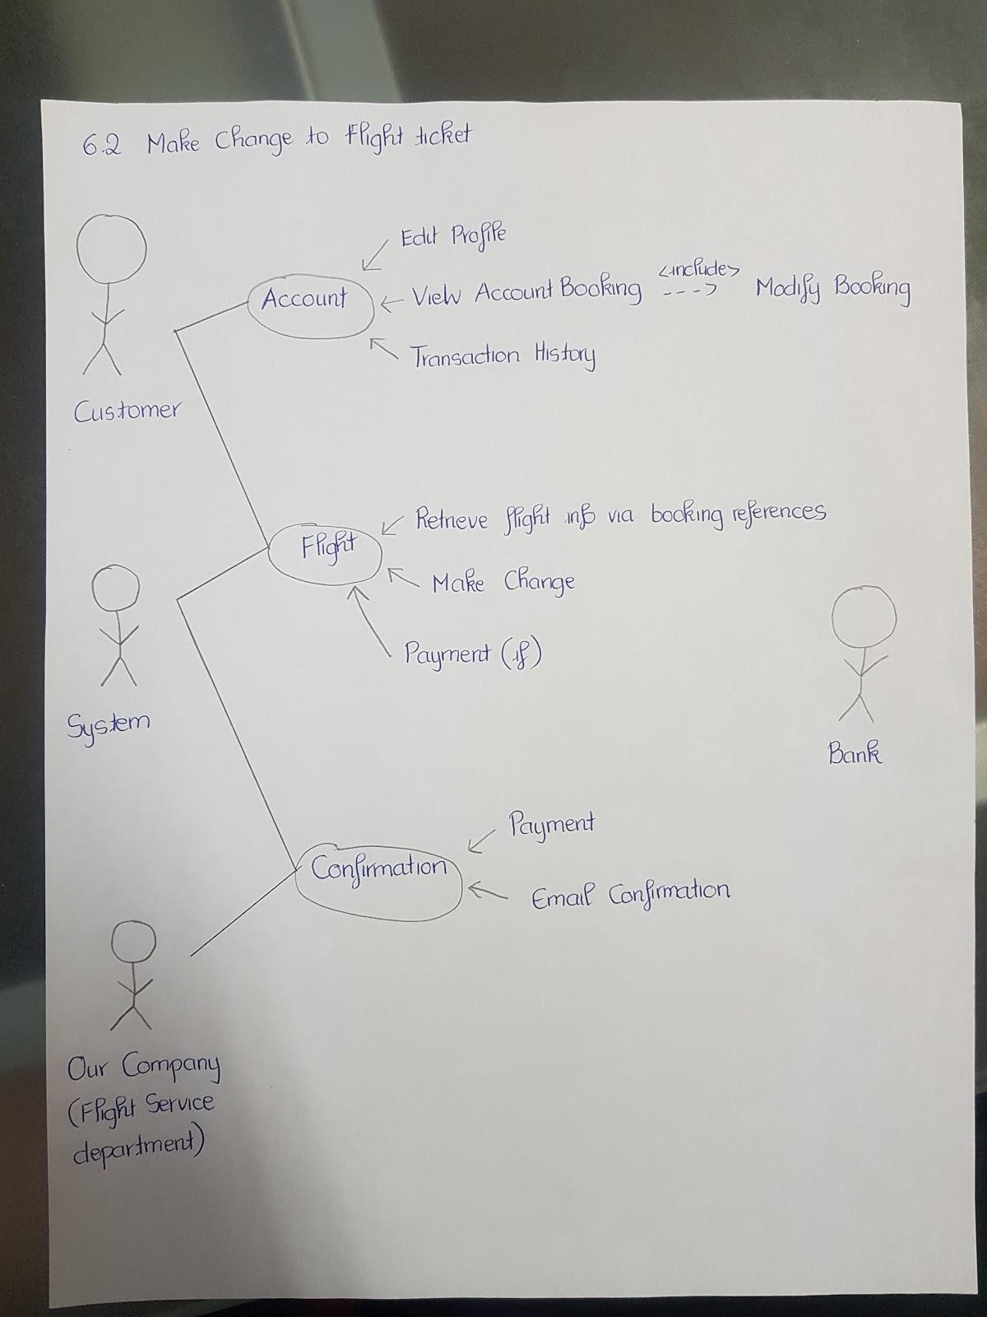
2. Flight Changes

Slide 7
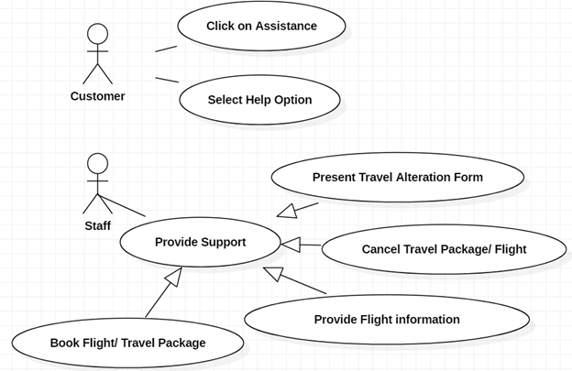
3. Customer Support System

Slide 8
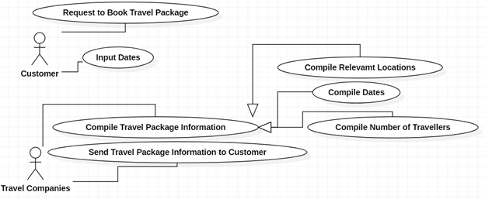
4. Vacation Package Deal

Slide 9
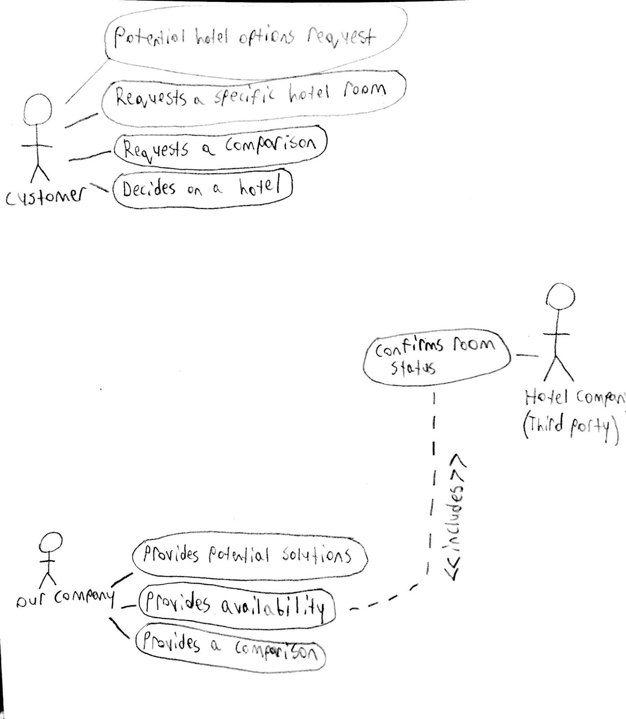
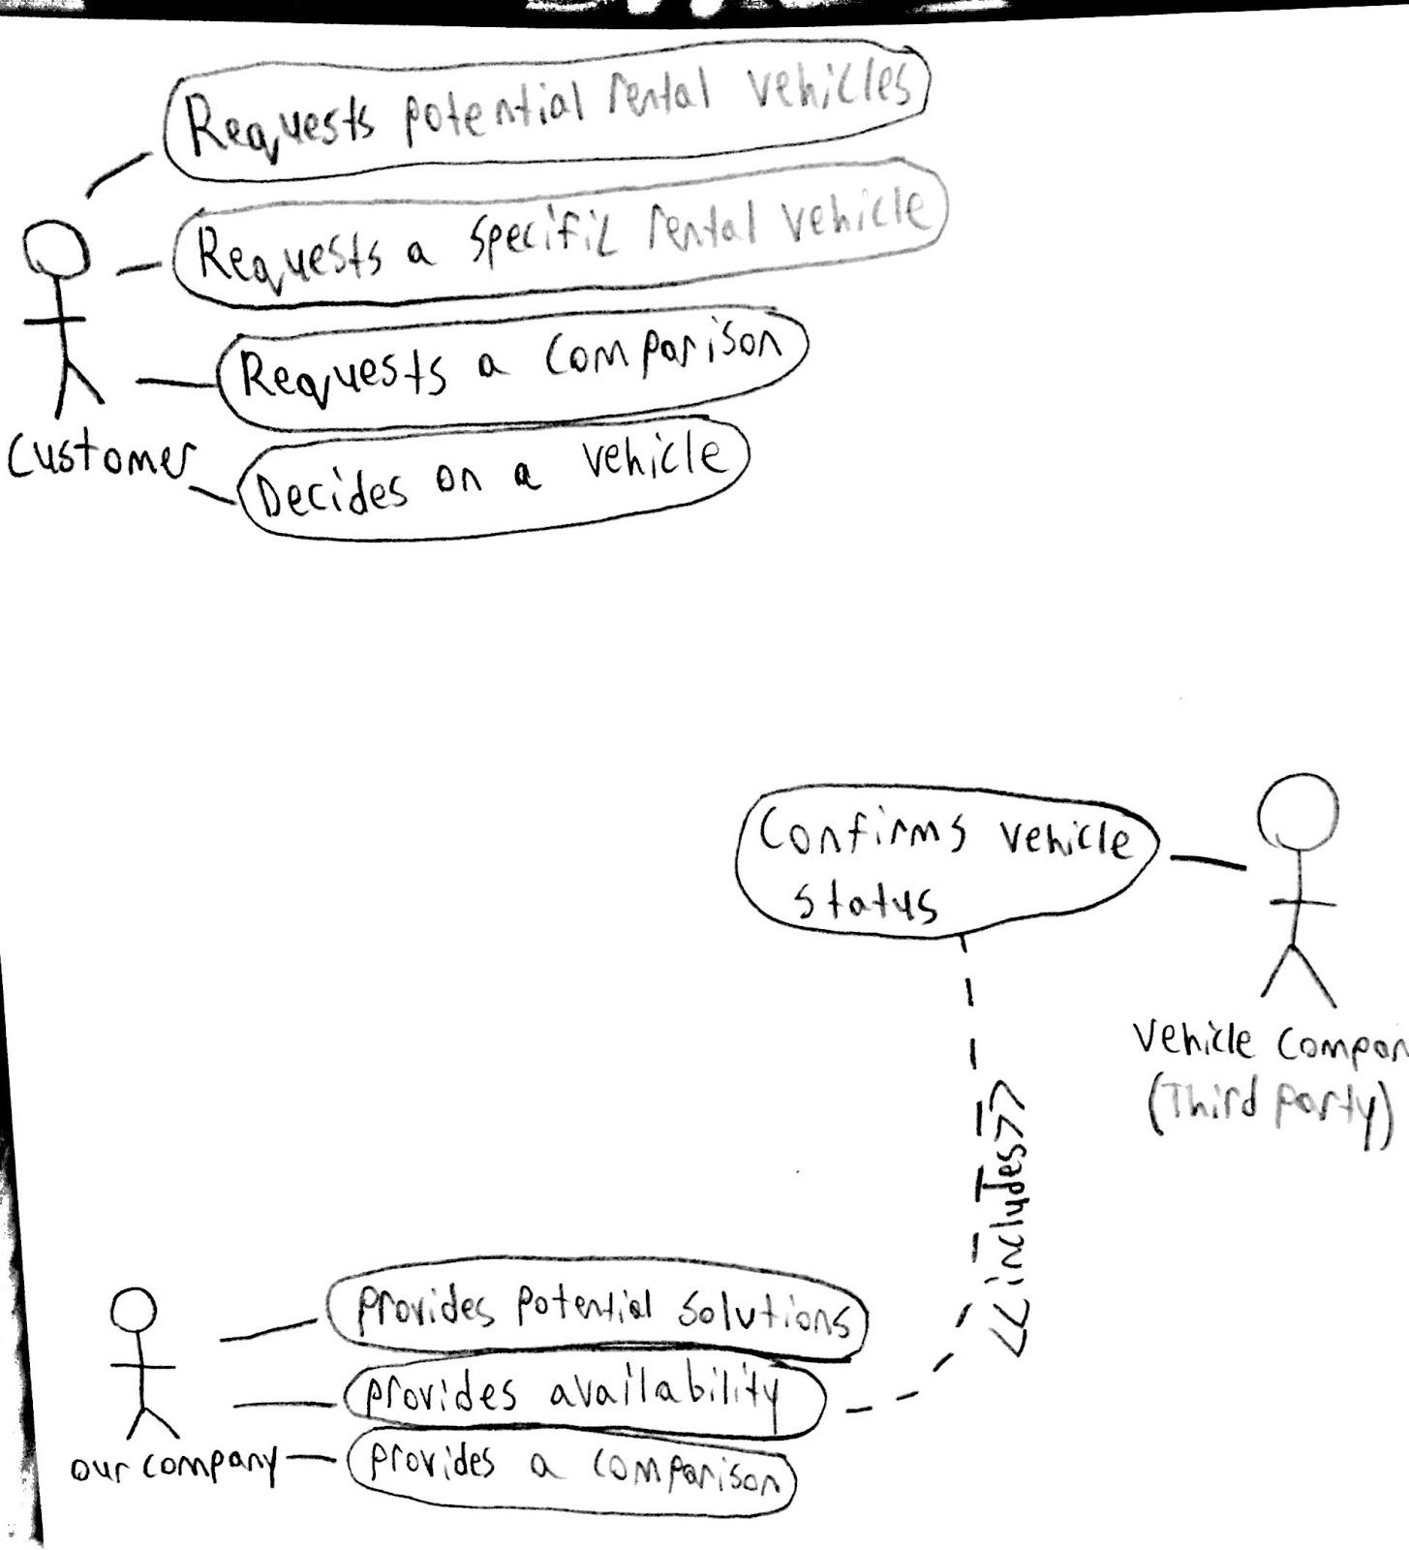
5. Price match for Hotel/Rental Cars

Slide 10
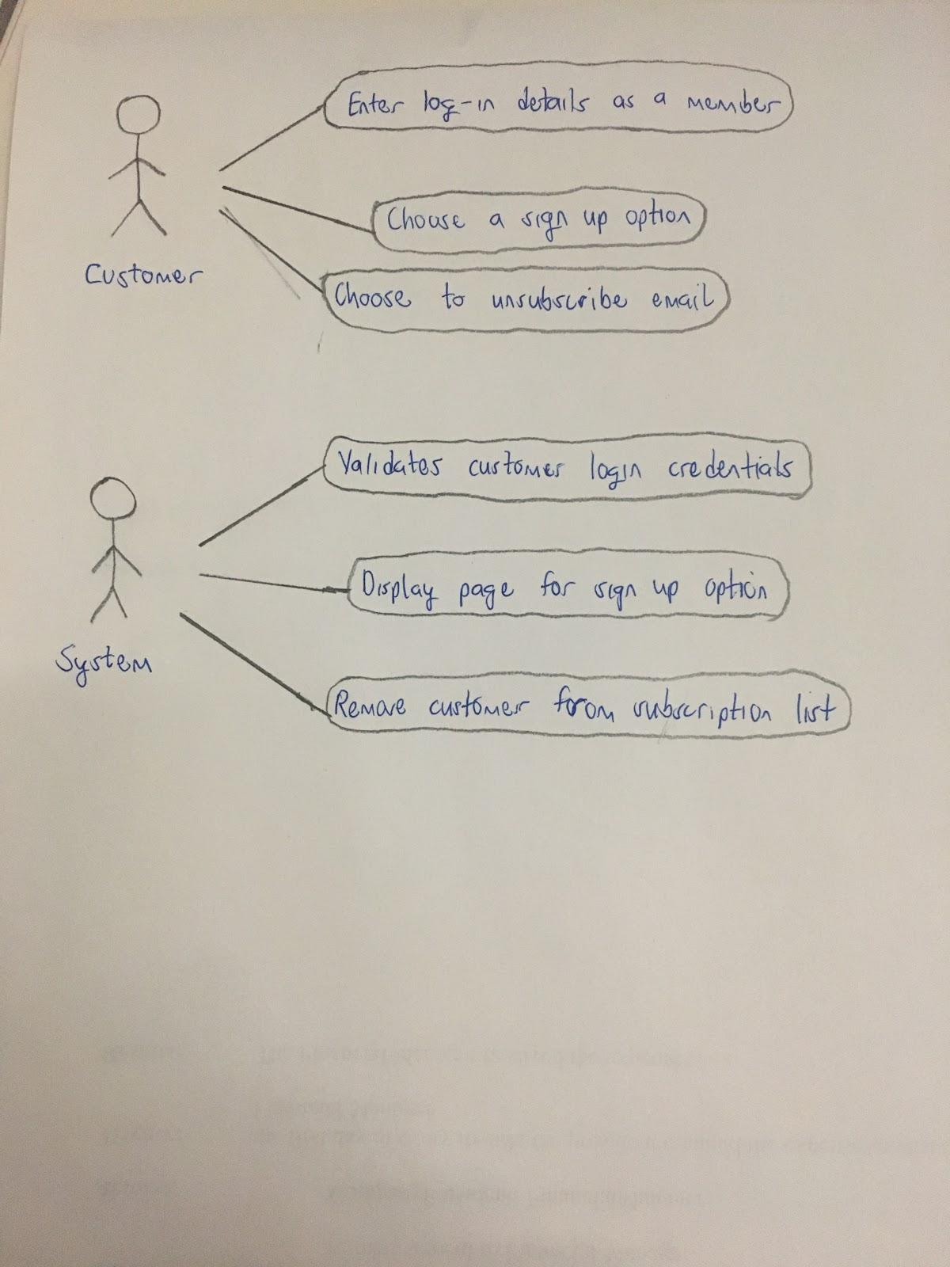
6. Membership System

Slide 11
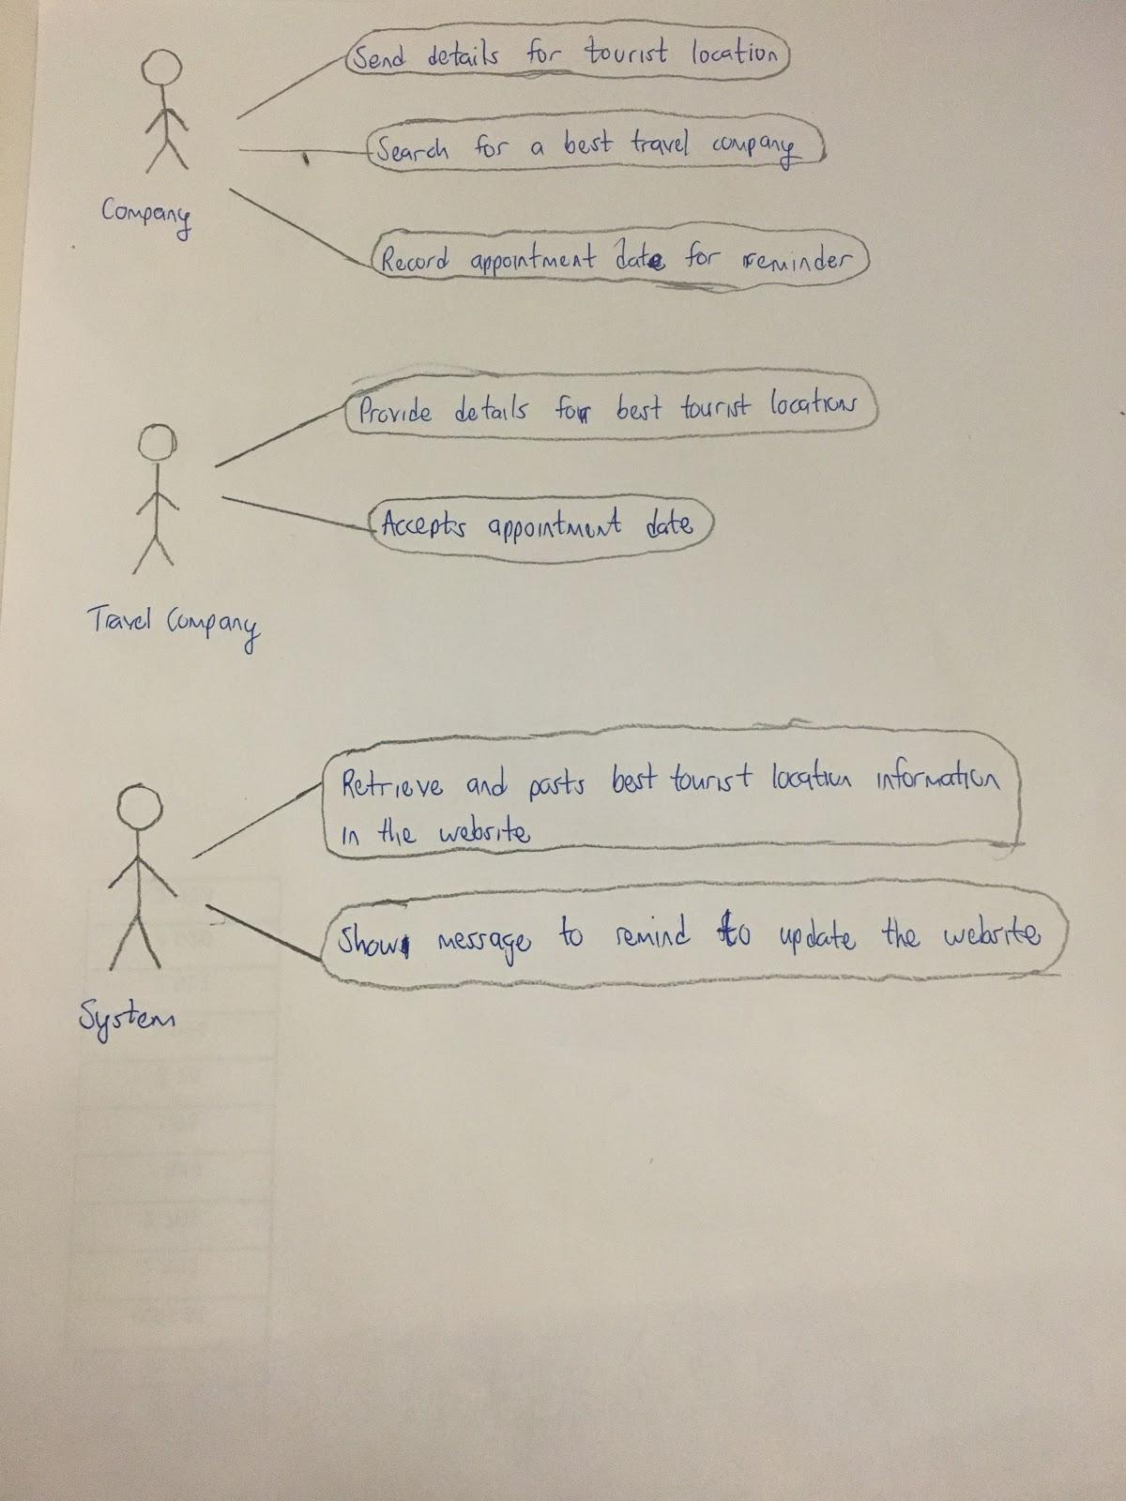
7. Recommendation for Flight/Hotel/Rental Cars/Package

Slide 12
BENEFITS
1. It saves time and money, if that's what you care
2. The online guys provide expert insights and a safety net to your trip
3. It's easy to check out what people say about them
4. They can make your multi-destination holiday seamless

Slide 13
Non-Functional System
Functionality
This business system satisfied most of the user’s requirement in term of deals, price-matching, and accuracy. However, we do not guarantee this included all data system such as airlines or hotels.
Performance Efficiency
Right now, the system only able to handle 10 transactions per minutes due to security reason. We are looking for a solution to allow users a faster payment method.
Localization
Our business model only available in English at the moment so it's a restriction to some person

